Slide 1
Happy Birthday, America
How can we help our country?

Slide 2
A Prayer for America
if My people who are called by My name will humble themselves, and pray and seek My face, and turn from their wicked ways, then I will hear from heaven, and will forgive their sin and heal their land.
  2 Chronicles 7:14

Slide 3
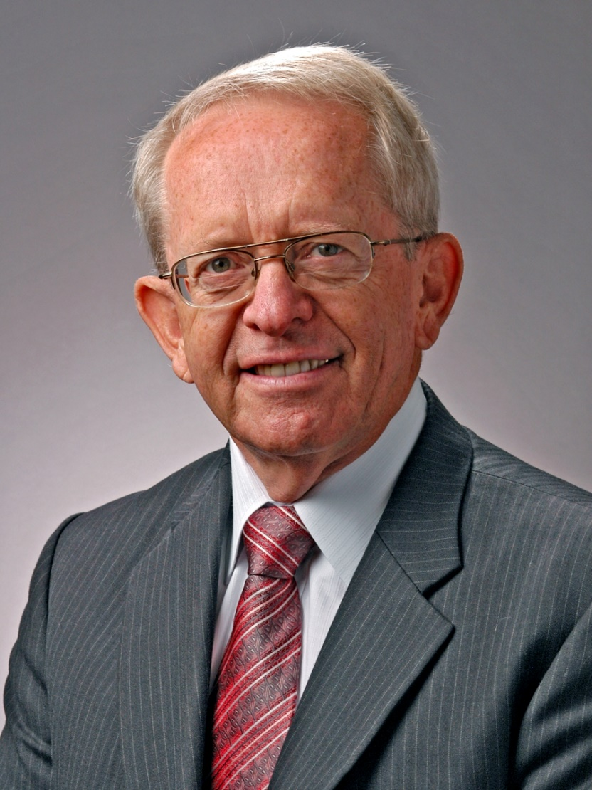
Dr. John Hannah, DTS
RHMA lecture, April, 2009

Slide 4
America’s Beginning
Puritanism. (View of the vast majority of colonists.)
  There is a God.
  He is the Creator, and He is Holy.
  We must conform to His standards.
  Faith in Jesus Christ is the only way of salvation.

Slide 5
America’s Beginning
Deism. (Secularism). (Minority view, but disproportionately influential among founders.)
  God created the Universe, then stepped back and watched.
  Denied Christ’s deity, inspiration of Bible, miracles.
  George Washington, Thomas Jefferson, James Madison and Benjamin Franklin leaned toward Deism.

Slide 6
Our Nation’s Founding Documents
In our Declaration of Independence, for example, there is reference to “Nature’s God,” to “their Creator,” and to “the protection of Divine Providence.”
Nowhere in our founding documents is there a reference to Jesus Christ. Why not?
Because they could not agree on who Jesus is.

Slide 7
Why did the Puritans compromise with the Secularists?
At the Federal level, our nation began, if at all, with a small c for Christian.
At the State level, our nation began with a Capital C for Christian.
Why did the Puritans compromise with the Secularists?

Slide 8
Why did the Puritans compromise with the Secularists?
The Christians believed that their State Constitutions would protect them from the Federal Constitution.
Were they right?

Slide 9
What would be the prevailing view of the country?
Our nation was founded in such a way that the majority view would prevail on a given subject.
As long as the majority of those among the people and those in power were Christian, the nation would follow Christian principles and standards.

Slide 10
What would be the prevailing view of the country?
But if the secularists rose to power, the nation would follow secularism.
God, in His grace, has granted our country three huge reprieves from secularism. These are the Great Awakenings.

Slide 11
The First Great Awakening
1720’s – 1760’s
(1740-1742)

Slide 12
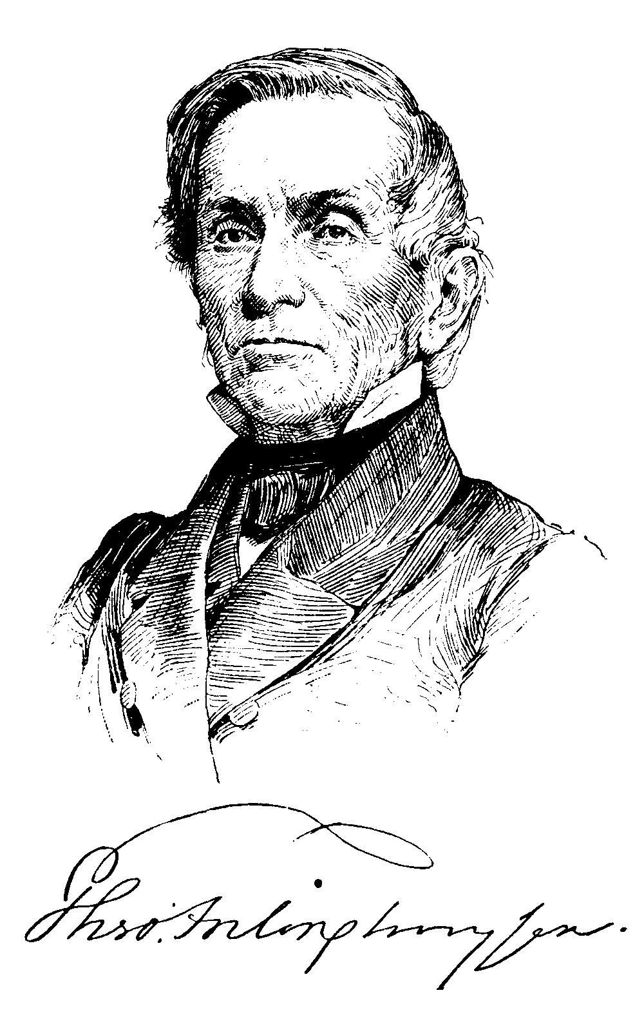
Pastoral Influences
Theodorus J. Frelinghuysen
1692-1747
Dutch Reformed,
New Jersey
Came to NJ in 1720
Preached practical Christian living
Awareness of God’s holiness
Emphasized personal conversion & holiness
Series of revivals, 1720’s

Slide 13
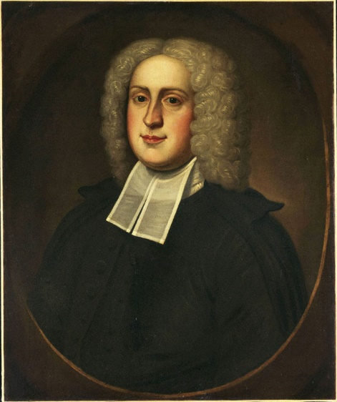
Pastoral Influences
William Tennent, Sr.
1673-1746
Presbyterian,
New Jersey
Had six sons
Built a log cabin college
Trained his sons and 24 others to become Presbyterian ministers

Slide 14
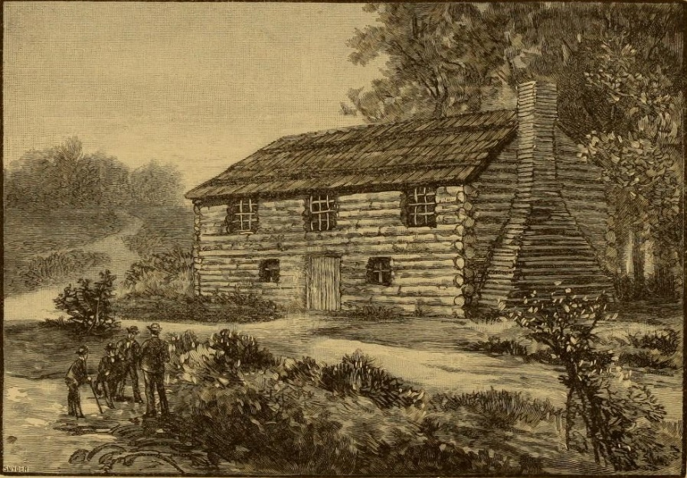
Pastoral Influences
Effects of Log College
William Tennent’s Log College, 1726
Provided an excellent education for prospective ministers.
These ministers would move and start their own log cabin college.

Slide 15
Pastoral Influences
Effects of Log College
William Tennent’s Log College, 1726
64 colleges & universities
Princeton University
University of Pennsylvania
Christian faith spread.

Slide 16
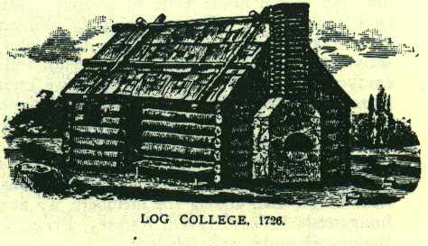
Pastoral Influences
Effects of Log College
William Tennent’s Log College, 1726
64 colleges & universities
Princeton University
University of Pennsylvania
Christian faith spread.

Slide 17
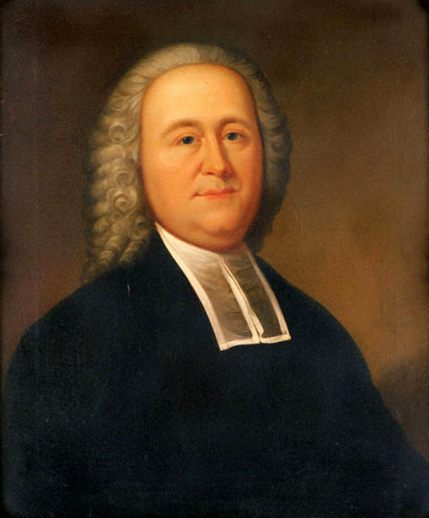
Pastoral Influences
Gilbert Tennent
1703-1764
Presbyterian
New Jersey
Son of William Tennent
Encouraged by Frelinghausen
Need for conversion, holy living
Converted souls & rededicated saints

Slide 18
Pastoral Influences
Gilbert Tennent
1703-1764
Presbyterian
New Jersey
Toured New England 1740-41
Preached on danger of unconverted ministers

Slide 19
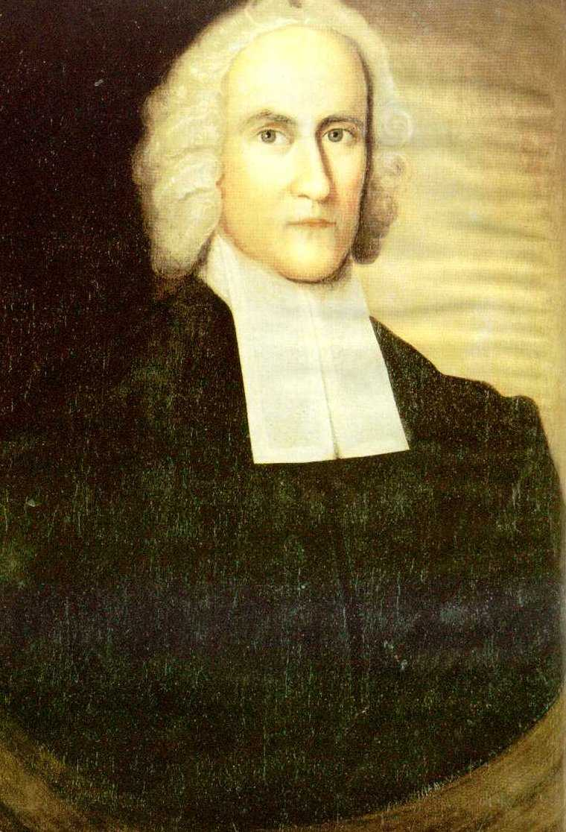
Pastoral Influences
Jonathan Edwards
1703-1758
Congregationalist, Massachusetts
Entered Yale age 12
Consumed with God’s love
1734 – began preaching on justification by faith
Awakenings began in his church

Slide 20
Pastoral Influences
Jonathan Edwards
1703-1758
Congregationalist, Massachusetts
“Sinners in the hands of an angry God”
Outstanding theologian

Slide 21
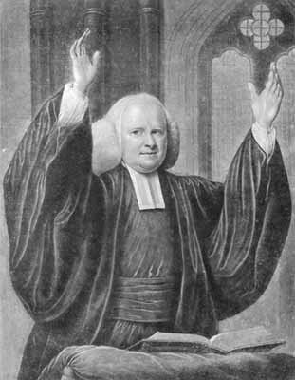
Pastoral Influences
George Whitefield
1714-1770
Anglican,
England
Friend of Wesleys at Oxford in England
Converted, became powerful preacher
Excluded by Anglican ministers, began preaching outdoors
Came to America 1738

Slide 22
Pastoral Influences
George Whitefield
1714-1770
Anglican,
England
Ben Franklin – estimated he could preach to 30,000
Outstanding evangelist

Slide 23
What was the impact of these pastors?

Slide 24
Impact of 1st Awakening
Colonial Church Growth
Denomination | 1700 | 1780

Slide 25
Impact of 1st Awakening
Colonial Church Growth
Denomination | 1700 | 1780
German Reformed | 0 | 201

Slide 26
Impact of 1st Awakening
Colonial Church Growth
Denomination | 1700 | 1780
German Reformed | 0 | 201
Lutheran | 7 | 240

Slide 27
Impact of 1st Awakening
Colonial Church Growth
Denomination | 1700 | 1780
German Reformed | 0 | 201
Lutheran | 7 | 240
Dutch Reformed | 26 | 127

Slide 28
Impact of 1st Awakening
Colonial Church Growth
Denomination | 1700 | 1780
German Reformed | 0 | 201
Lutheran | 7 | 240
Dutch Reformed | 26 | 127
Presbyterian | 28 | 495

Slide 29
Impact of 1st Awakening
Colonial Church Growth
Denomination | 1700 | 1780
German Reformed | 0 | 201
Lutheran | 7 | 240
Dutch Reformed | 26 | 127
Presbyterian | 28 | 495
Baptist | 33 | 457

Slide 30
Impact of 1st Awakening
Colonial Church Growth
Denomination | 1700 | 1780
German Reformed | 0 | 201
Lutheran | 7 | 240
Dutch Reformed | 26 | 127
Presbyterian | 28 | 495
Baptist | 33 | 457
Anglican | 111 | 406

Slide 31
Impact of 1st Awakening
Colonial Church Growth
Denomination | 1700 | 1780
German Reformed | 0 | 201
Lutheran | 7 | 240
Dutch Reformed | 26 | 127
Presbyterian | 28 | 495
Baptist | 33 | 457
Anglican | 111 | 406
Congregational | 146 | 749
United States History for Christian Schools, p. 80

Slide 32
The Impact of the 1st Awakening
God blessed our country before it ever began.
God raised up men of God from both England and America to preach powerful messages of Biblical truth.
Thousands upon thousands were converted to Christ.

Slide 33
The Impact of the 1st Awakening
The gospel was a leveler – an equalizer (“all men are created equal”) – All have worth, not just the upper crust.
There was a Christian core in America at its founding.
Alan Heimert: “What was awakened in 1740 was the spirit of the American democracy.”

Slide 34
What can we do with what we have learned?
We must pray again for God to have mercy on our country.
We must pray that God will raise up men who will have a dramatic spiritual impact on our country.
We must pray that God will use us to do our part in sharing Jesus Christ with our friends and neighbors.

Slide 35
The Second Great Awakening
1790 – 1840’s

Slide 36
The Background of the 2nd Great Awakening
Secularism was gaining the upper hand.
For many Americans, drinking and gambling were more important than any creed.
John Marshall, Supreme Court Justice: The church was “too far gone ever to be revived.”

Slide 37
The Background of the 2nd Great Awakening
But God had raised up John Wesley in England (Methodist).
In England he preached the need for conversion to Christ and holy living.
Methodist Francis Asbury came to America in 1782

Slide 38
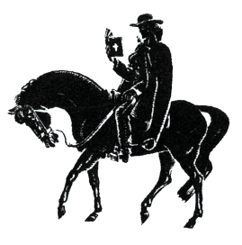
The Background of the 2nd Great Awakening
Circuit Riding Preacher
Methodist Circuit Riders
Tough men with tender hearts
Francis Asbury – 300,000 miles on horseback

Slide 39
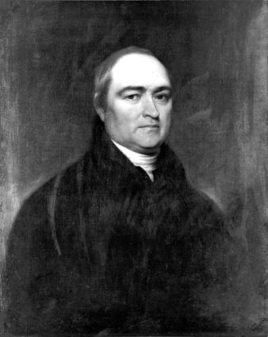
The Start of the 2nd Great Awakening
Timothy Dwight IV
President of Yale, 1795
“The college was in a most ungodly state. The college church was extinct. Most of the students were skeptical, and rowdies were plenty.”

Slide 40
The Start of the 2nd Great Awakening
Timothy Dwight IV
President of Yale, 1795
“Wine and liquors were kept in many rooms; intemperance, profanity, gambling, and licentiousness were common.”

Slide 41
The Start of the 2nd Great Awakening
Timothy Dwight IV
President of Yale, 1795
Grandson of Jonathan Edwards.
Held public debates on Christianity.

Slide 42
The Start of the 2nd Great Awakening
Timothy Dwight IV
President of Yale, 1795
Preached basic Christian theology in chapels.
1/3 of students converted!

Slide 43
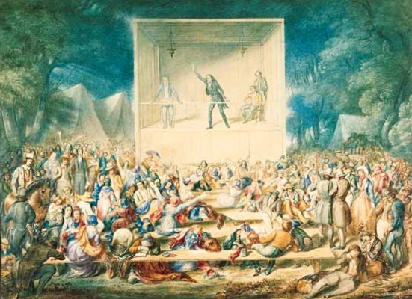
Camp Meetings in the West
Methodist Camp Meeting 1839
Presbyterian James McGready started first camp meeting, 1800, Logan, Kentucky

Slide 44
Camp Meetings in the West
Methodist Camp Meeting 1839
1801 Cane Ridge camp meeting drew 10,000- 25,000

Slide 45
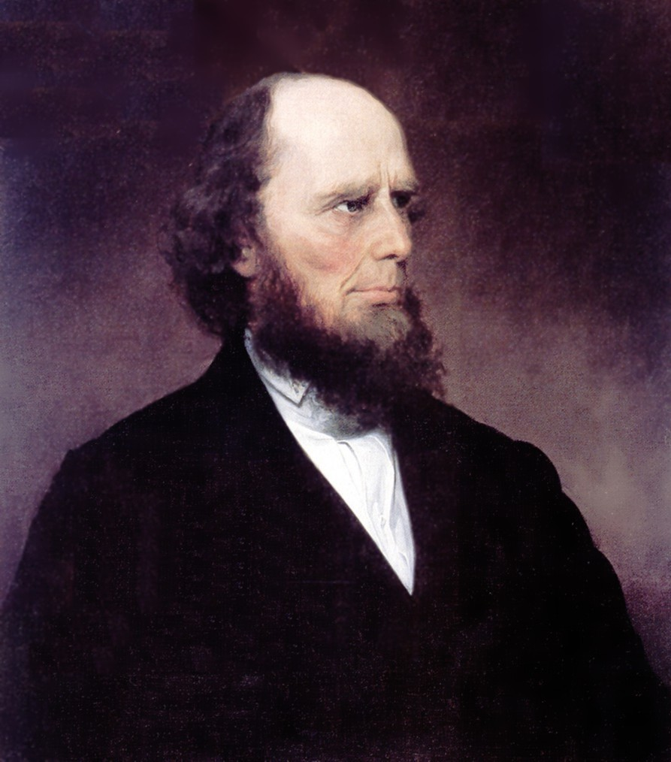
The Ministry of Charles G. Finney
Charles G. Finney
1792-1875
Father of American Evangelists
Converted in 1821 at a revival.
Studied under a Pres. Minister
Began preaching in New York State

Slide 46
The Ministry of Charles G. Finney
Charles G. Finney
1792-1875
Father of American Evangelists
1830’s – preaching to huge crowds in New York City
Preached on God’s judgment for sin

Slide 47
The Ministry of Charles G. Finney
Charles G. Finney
1792-1875
Father of American Evangelists
“Anxious bench”
Protracted meetings” – up to several weeks in one location.

Slide 48
The Ministry of Charles G. Finney
Charles G. Finney
1792-1875
Father of American Evangelists
Most evangelists today use some of his methods

Slide 49
Impact of the 2nd Great Awakening
Yale became a missionary sending school.
The American Board of Commissioners for Foreign Missions was formed (America’s 1st foreign mission board). (Congregationalist)
Adoniram Judson and Luther Rice went to India in 1812 under ABCFM.

Slide 50
Impact of the 2nd Great Awakening
Adoniram Judson eventually served in Burma.
Luther Rice founded a Baptist mission organization.
American Bible Society founded.
American Tract Society founded.
Princeton became a Presbyterian beacon.
Thousands converted to Christ.

Slide 51
Impact of the 2nd Great Awakening
American Methodists alone grew from 15,000 in 1785 to 850,000 in 1840.
Moral sins declined. Drunkenness on the frontier declined.
The foundation for moral reform was laid – Prohibition; Abolition of Slavery.
A large segment of American society was transformed.

Slide 52
What can we do with what we have learned?
We must pray again for God to have mercy on our country.
We must pray that God will raise up men who will have a dramatic spiritual impact on our country.
We must pray that God will use us to do our part in sharing Jesus Christ with our friends and neighbors.

Slide 53
The Third Great Awakening
The Prayer Meeting Revival
1857-1859

Slide 54
Prelude to the 3rd Awakening
Slavery bedeviled America.
In a few years, the Civil War would break out. States’ rights and slavery were huge issues.
The slave triangle existed. Slaves to America from Africa; Sugar and molasses from America to England.
1837 and 1857 were depressions.

Slide 55
Prelude to the 3rd Awakening
Andrew Jackson defeated the Indians in the SW and transported them forever into Oklahoma. Forever was until they discovered oil there in 1860.
The war would split the Baptists and the Methodists.

Slide 56
The Prayer Meeting Revival
The revival began shortly after the financial Panic of 1857.
Someone hired Jay Lanphier to go door to door evangelizing.
He reasoned that people were not working from 12-1.
He decided to hold weekly prayer meetings in New York City.

Slide 57
The Prayer Meeting Revival
He sent out 100,000 handbills.
The first week 6 people showed up.
Two weeks later 30 showed up.
Finally, he held prayer meetings every day.

Slide 58
The Prayer Meeting Revival
The Dutch Reformed Church and every other New York City church were meeting at lunch for prayer.
No preachers ran these meetings.
They had prayer lists. If you have prayer lists with peoples’ names on them, you will be more likely to talk to them about the Lord.

Slide 59
The Prayer Meeting Revival
At 5 minutes to 1 a song would be announced. They would sing a song and leave.
The prayer meeting phenomenon spread to every major city in the U.S.

Slide 60
The Spread of the Revival
In Baptist Churches in New York City there were 70,000 accessions.
Between 500,000 and a million people were converted to Christ in America.
The Awakening spread to Ireland. A half million were converted to Christ. Prisons were shut down.

Slide 61
The Spread of the Revival
The revival spread to Scotland and Wales and England.
1 million converts in England.
The revival spread even to Australia, New Zealand, Hawaii, and Fiji

Slide 62
The Impact of the Revival
D. L. Moody was influenced, began Moody Bible Institute.
William Booth founded the Salvation Army.
The YMCA was able to expand its ministry.
Charles Haddon Spurgeon had great success in England because of the Revival.

Slide 63
The Impact of the Revival
Many Bible Institutes founded.
  Philadelphia School of the Bible; Northwestern Bible Institute; Moody Bible Institute; Spurgeon’s Pastor’s College
J. Hudson Taylor began the China Inland Mission.
Secularism was held at bay for almost 80 years!

Slide 64
What Can We Learn?
2019

Slide 65
What Can We Learn?
America is in rough shape.
In the past God has sovereignly raised up people to bring revival to America.
It has happened three big times in the past.
It can happen again.
The most important thing you and I can do is to pray.

Slide 66
What Can We Learn?
Pray for our country.
Pray that God will raise up men who will reclaim America for Christ
Pray for people you can lead to Jesus.

Slide 67
The Challenge:
Pick 2 People & Pray Daily for Their Salvation
____________________
____________________

Slide 68
Daily, Pray This Prayer for America
God, please help the people of America to humble themselves, and pray and seek Your face through Jesus Christ, and turn from their wicked ways, so that You will hear from heaven, and will forgive their sin and heal their land.
  Based on 2 Chronicles 7:14

Slide 69


